Slide 1
VAST CHALLENGE
2018 MC 1
Second Progress
Group Project by :
Batuhan Kir
Jun Yan Chen
Shravika Pinna
Chinmai Reddy Modugula
Kamal Afridi M S

Slide 2
Contributions
Batuhan Kir - Data Preprocessing via OpenRefine & Audacity(Slides-3, 5,6)
Jun Yan Chen - Audacity & Machine Learning Model(Slides-5,6,7,8,10)
Shravika Pinna - Machine Learning Model & Predictions(Slides-12,13,14,15)
Chinmai Reddy M - Machine Learning Model & Predictions(Slides-12,13,14,15)
Kamal Afridi M S - Audio Formatting & Machine Learning Predictions(Slides-3,14,15)
Slide 4 - previous tableau work remapped in python

Slide 3
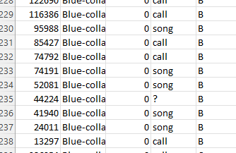
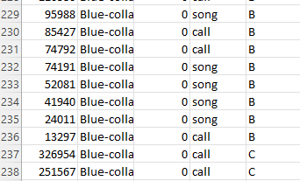
Data Cleaning & Normalization (OpenRefine)
Removing inconsistent data for “Vocalization Type” and “Quality”
Created a new column label by using ‘English Name’ column using GREL Expression.
if(length(value.find(/Rose Crested Blue Pipit/))>0,1,0)

Slide 4
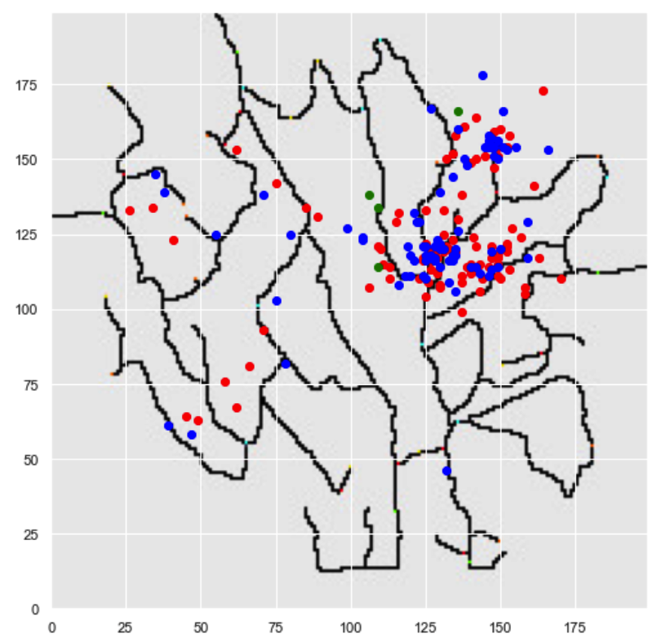
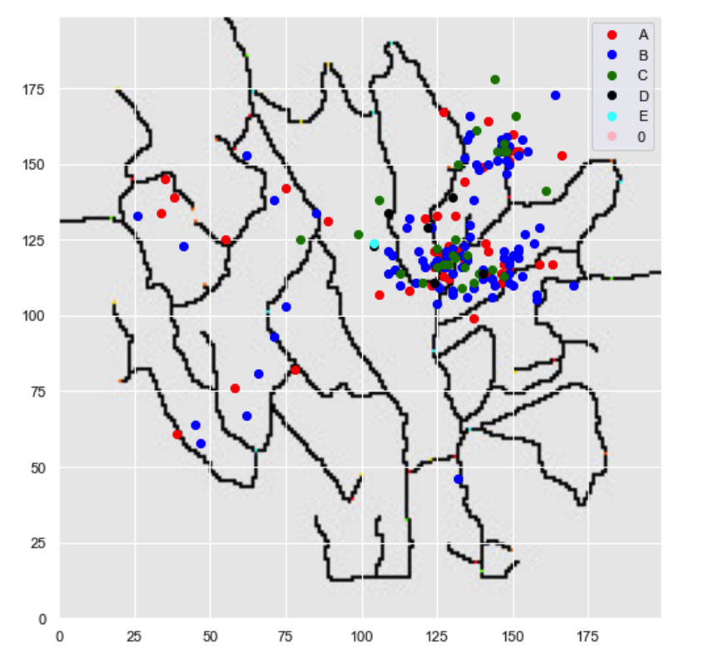
Geo Locations
Plot 1: Mapping Mitch’s Data WRT Vocalization type
Plot 2: Mapping Mitch’s Data WRT Audio Quality
Red - Call
Blue - Song
Green - Call, Song
A B C D E - Quality

Slide 5
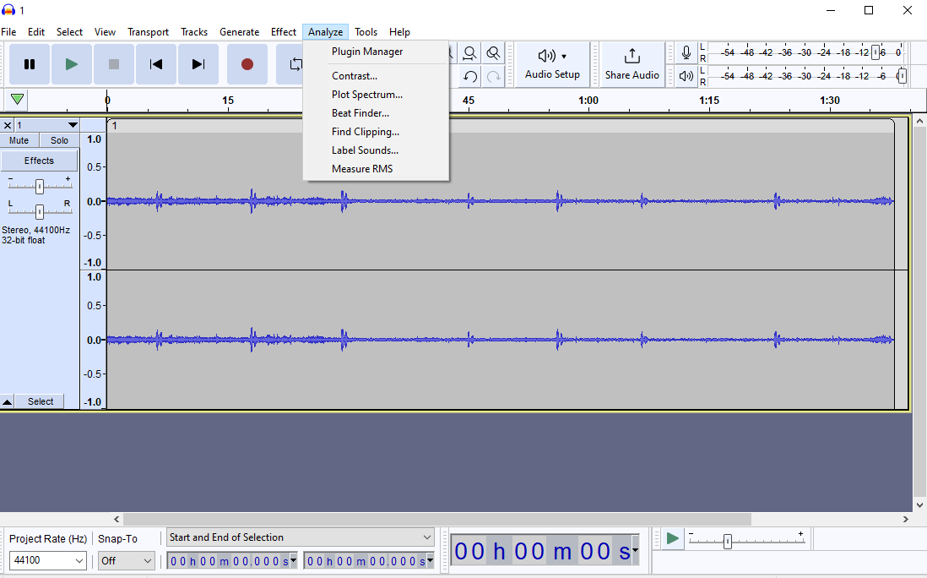
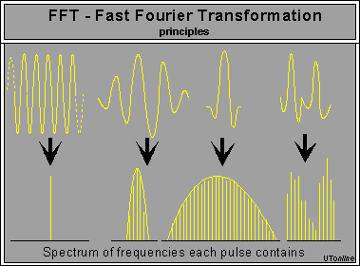
Spectrum Analysis (Audacity)
Audacity - free open source audio software
Plot Spectrum separates audio into blocks, and uses Fast Fourier Transform or FFT to convert waveform to spectrum, and then averages all the blocks together.
Spectrum - The sound intensity/amplitude(dB) at each frequency(Hz).

Slide 6
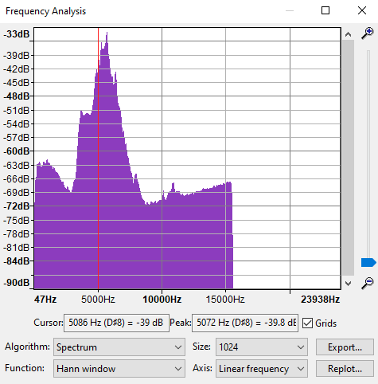
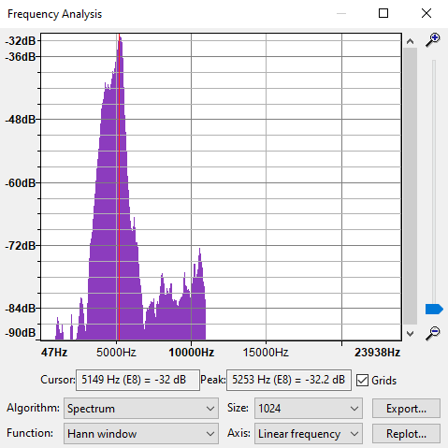
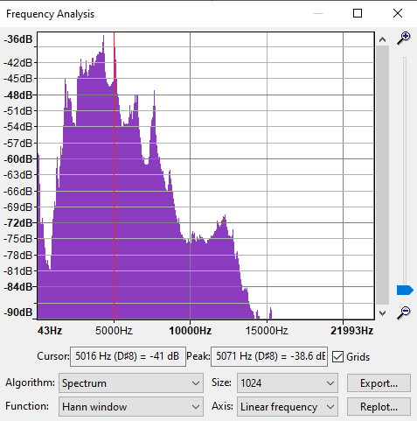
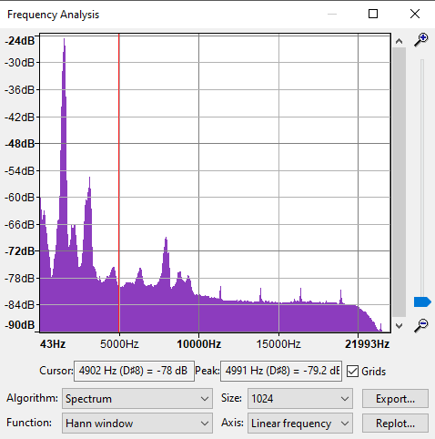
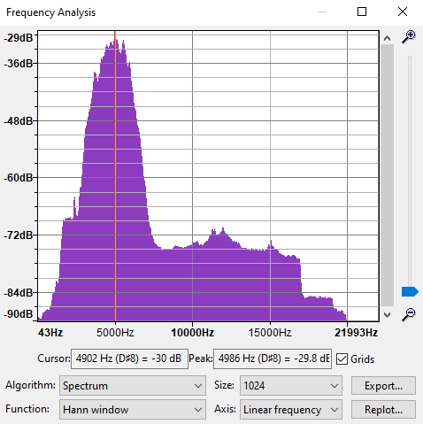
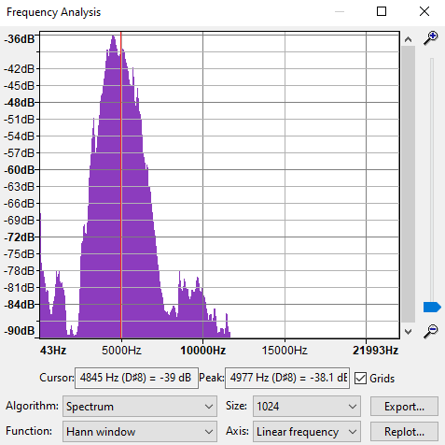
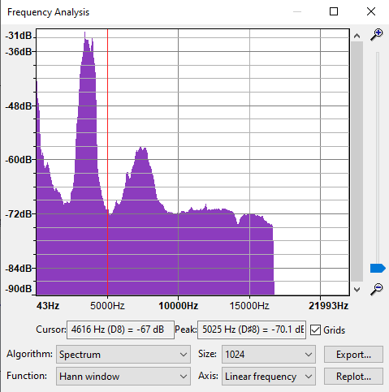
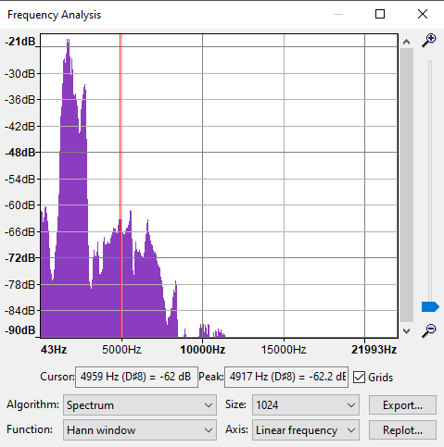
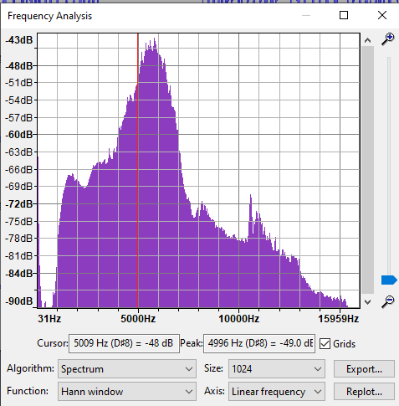
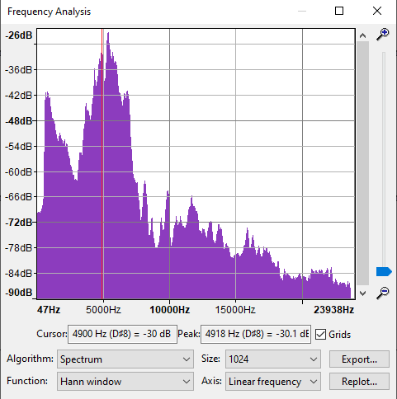
Eyeball Observation
351273
299736
4
5
14877
162563
6
7
298739
110765
Kasios
Mitch

Slide 7
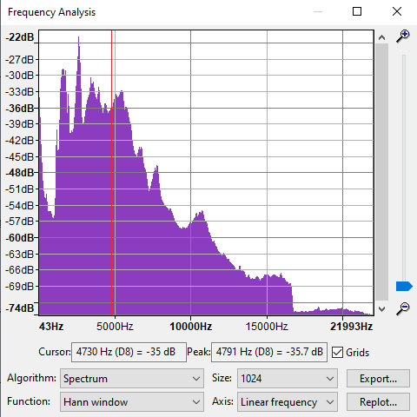
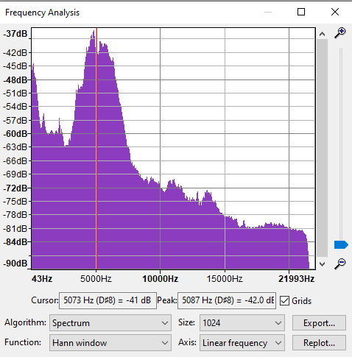
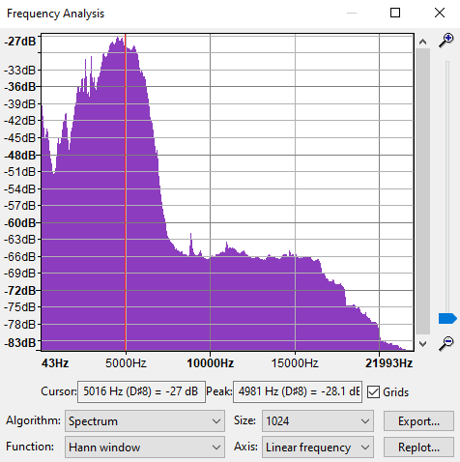
Kasios Data
Mitch Data
blue pipits audio, Quality “A”
Average of all 15 audios
Vocalization type “call” average
Vocalization type “song” average

Slide 8
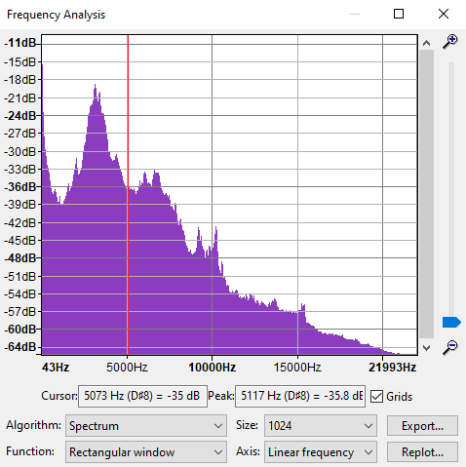
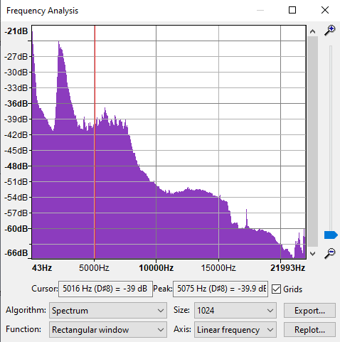
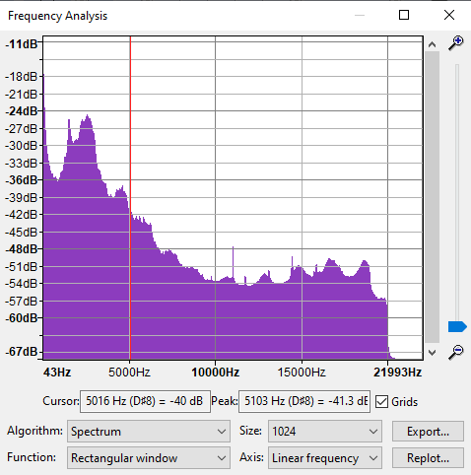
Other Bird Species
Bent-Beak-Riffraff
Average
Vermillion-Trillian
Average
Scrawny-Jay
Average

Slide 9
Machine Learning Approach
Train Data: Mitch audio data - AllBirds
Test Data: Kasios Test Audios - 15 Test Audios
Platform: Jupyter Notebook
Packages: Matplotlib, Sklearn, Librosa,
Audio features for model training and prediction:
Root Mean Square Energy, chromagram short-time fourier transform, spectral centroid
Classification Methods:
K-Nearest Neighbors
Decision Tree
Random Forest
Gaussian Naive Bayes

Slide 10
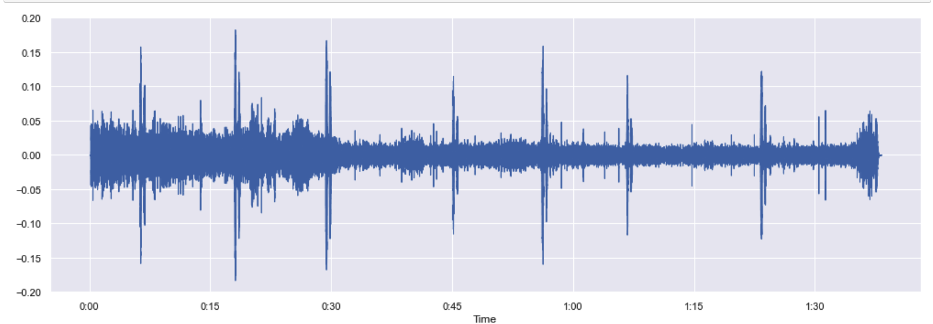
Audio Features
Time Series Amplitude Analysis of Kasios 1.wav

Slide 11
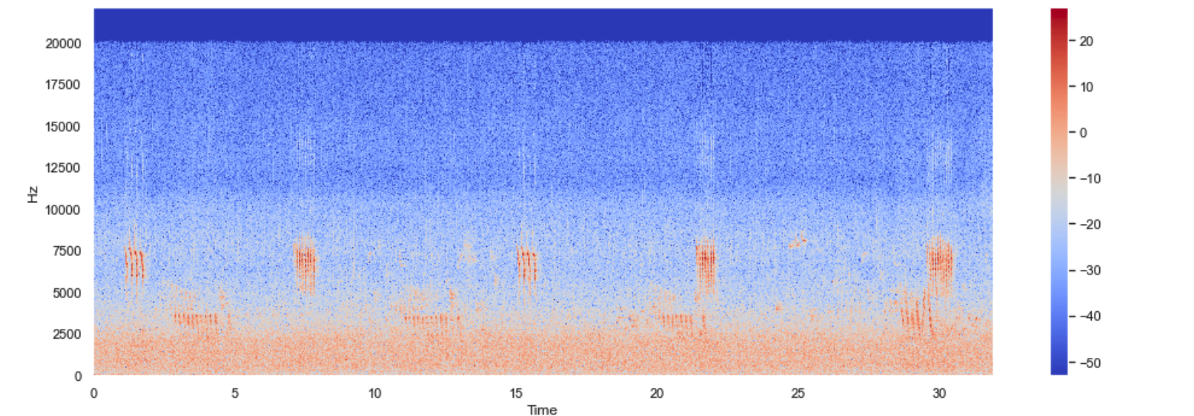
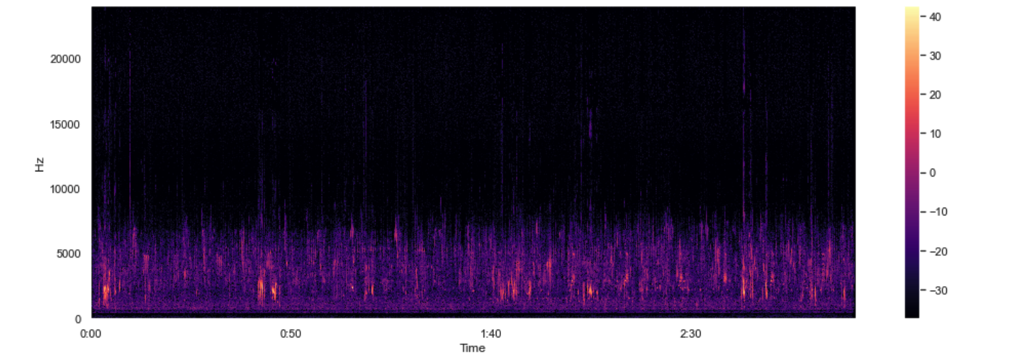
Audio Features
Samples of frequency spectrum in Mitch Data

Slide 12
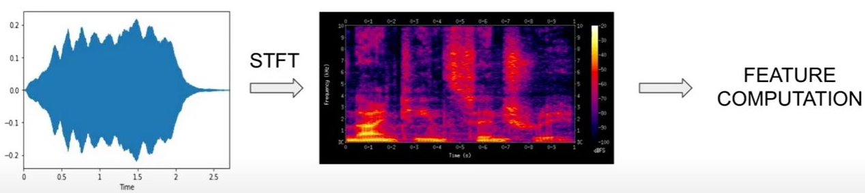
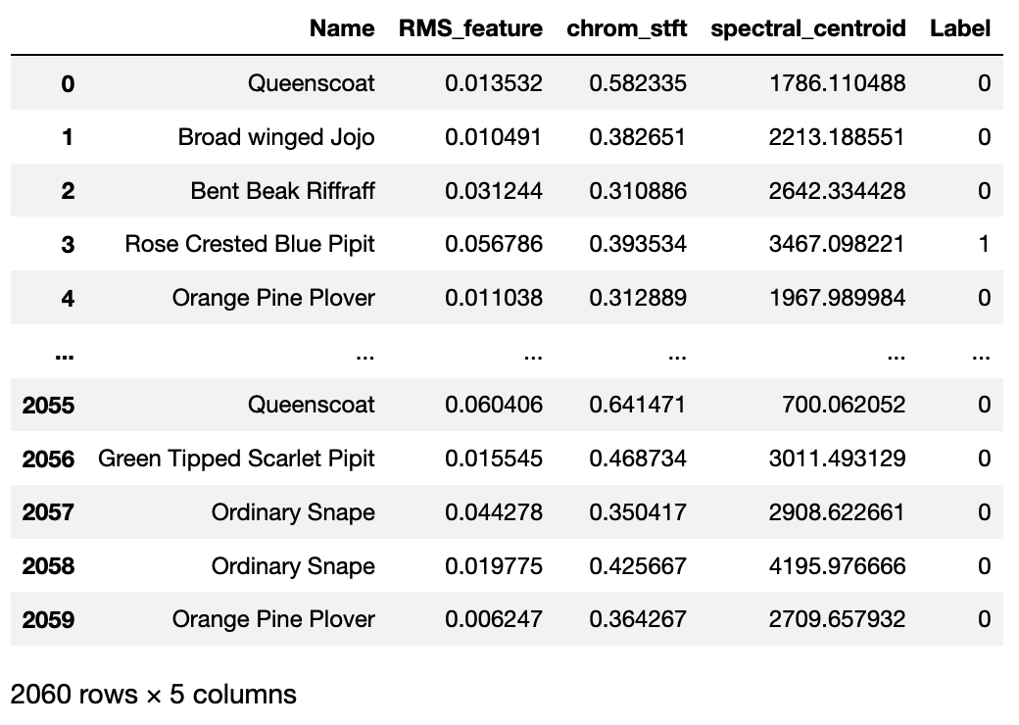
Feature Extraction
Root Mean Square Energy
Chromagram short-time fourier transform
Spectral centroid

Slide 13
Classification Methods
Four Machine Learning Classification models were implemented for training data.
Random Forest
KNN
Decision trees
Gaussian Naive Bayes

Slide 14
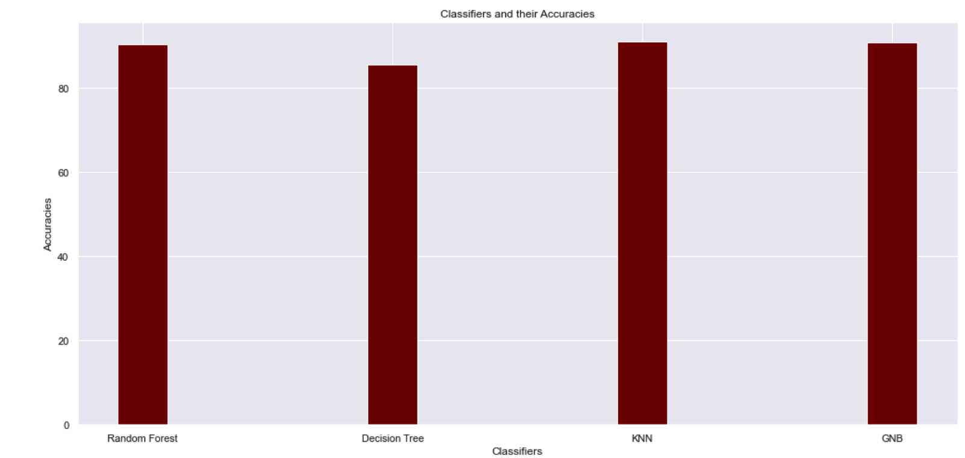
Model Accuracies

Slide 15
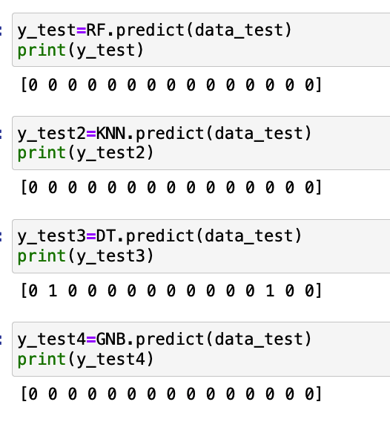
Prediction Results

Slide 16
Conclusion
Based on the results from our observations and outputs from the machine learning models, we conclude that:
The data provided by Kasios does not contain only Rose Crested Blue Pipits.
Thus it does not support Kasios’s claim against the research results.

Slide 17
Thank You

